Slide 1
Ningbo Health Textile Co., Ltd.
New fabrics and curtains in Jul. 2023
----- We are curtain cushion specialist

Slide 2
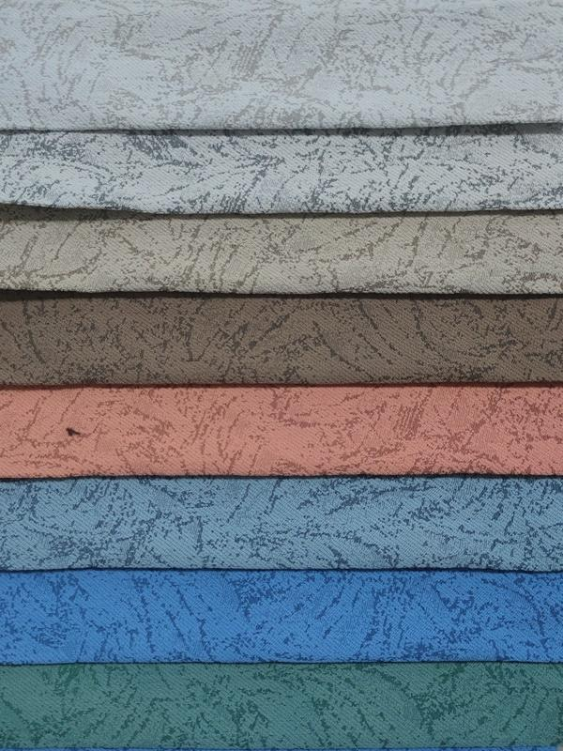
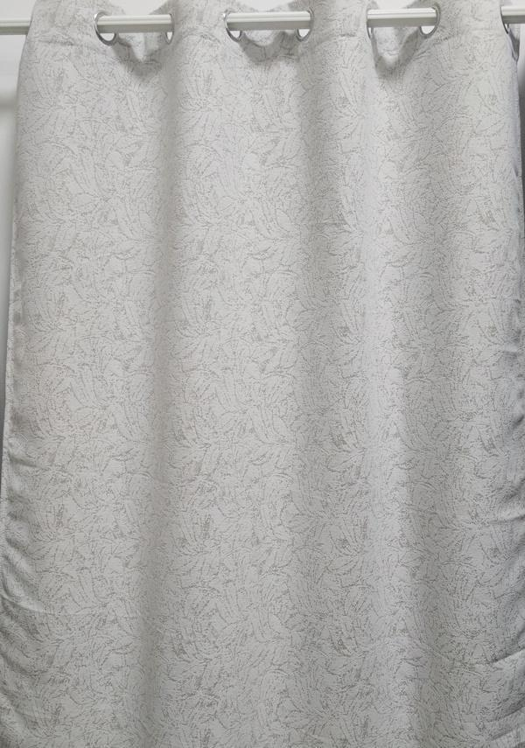
Ningbo Health Textile Co.,Ltd
Style No.HS12108J/230572

Slide 3
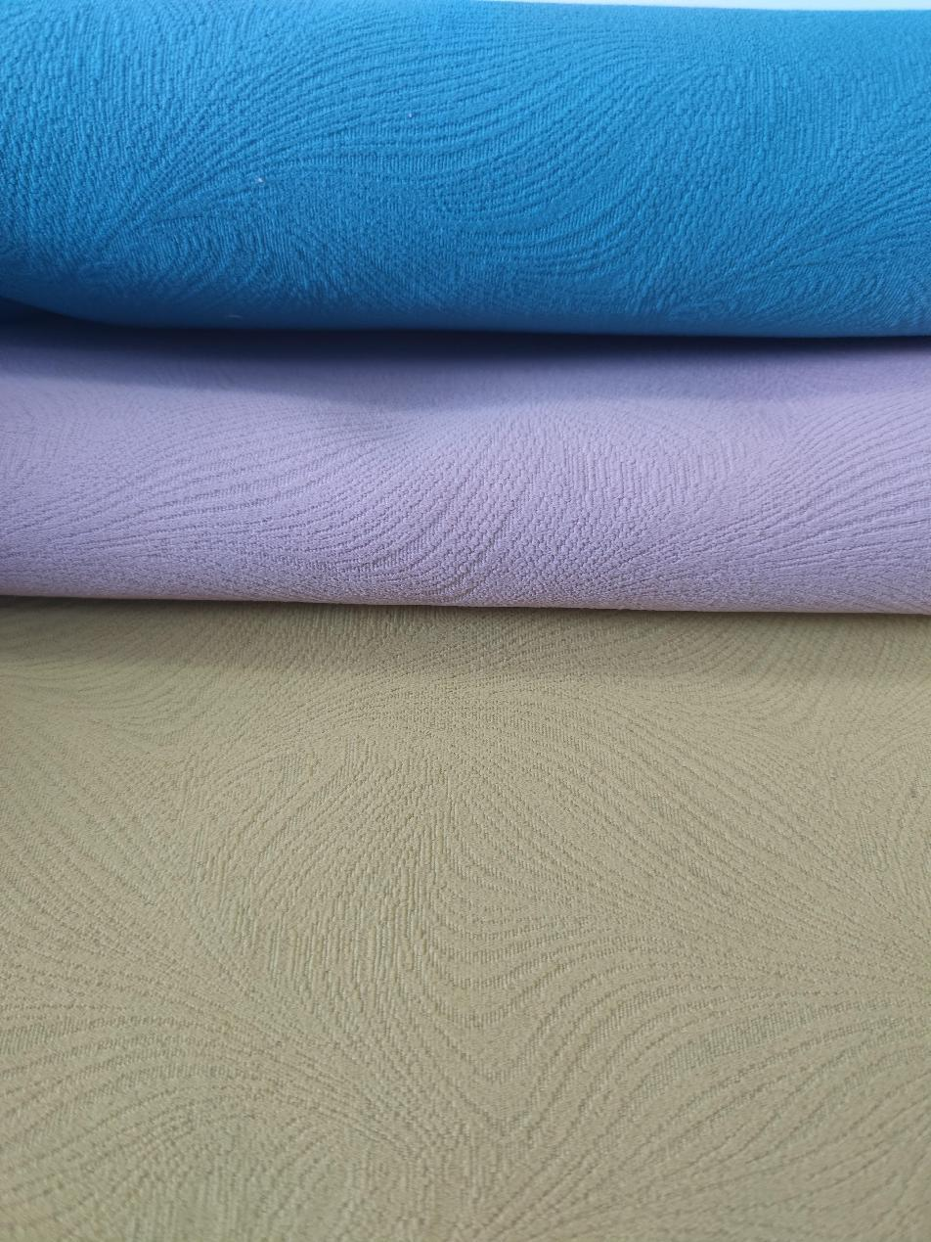
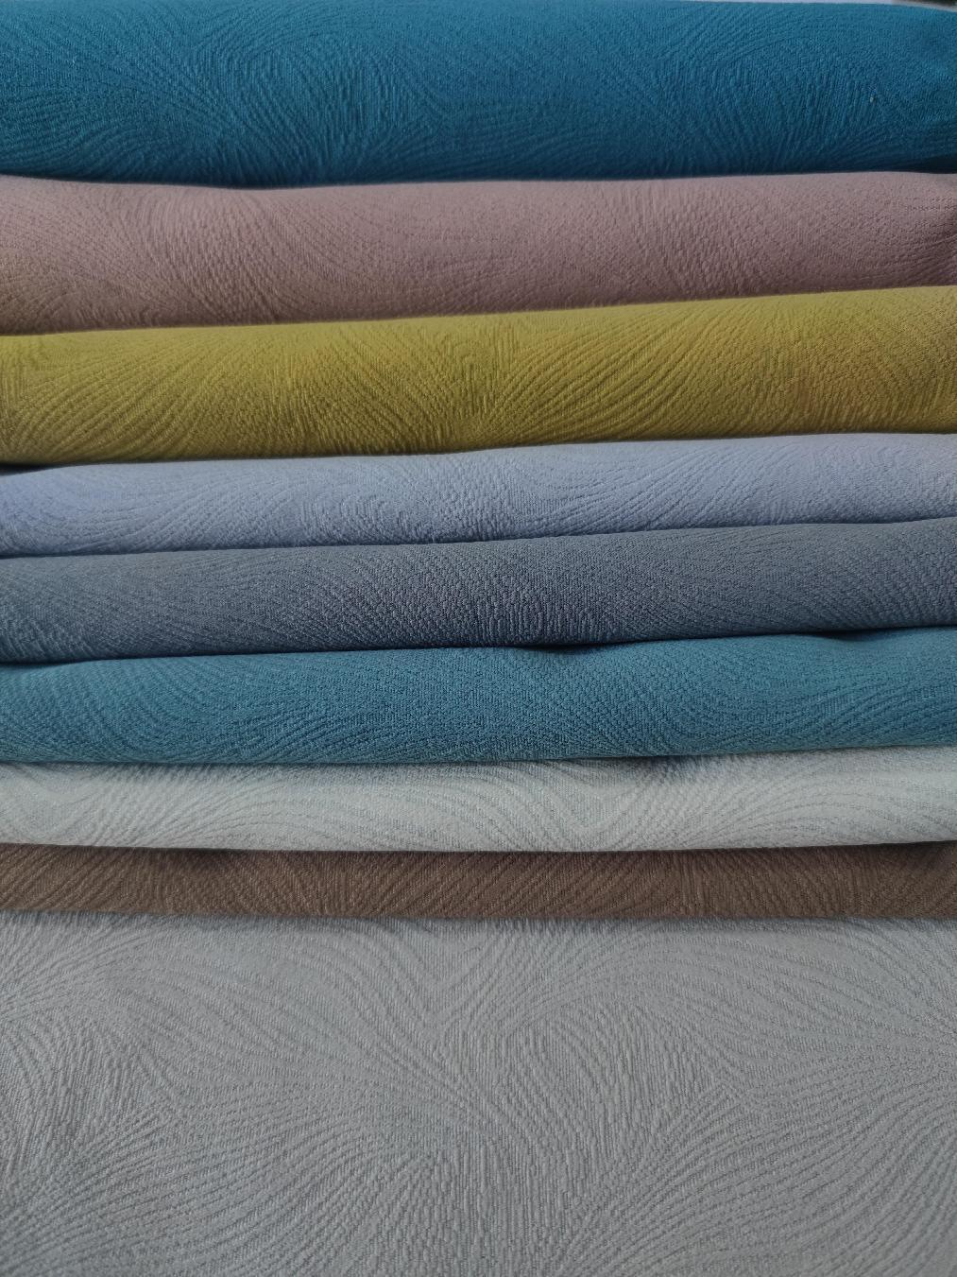
Ningbo Health Textile Co.,Ltd
Style No.HS12084

Slide 4
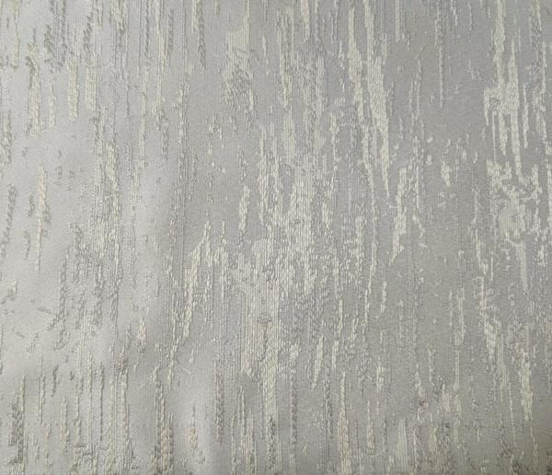
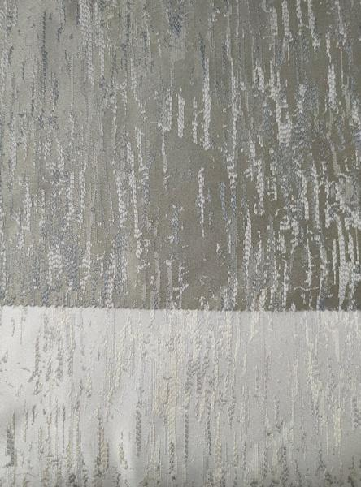
Ningbo Health Textile Co.,Ltd
Style No.HS12124

Slide 5
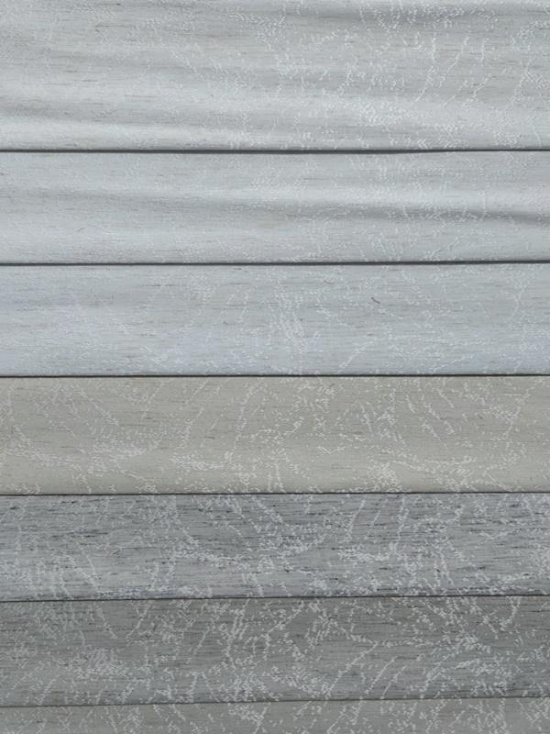
Ningbo Health Textile Co.,Ltd
Style No.HS12132

Slide 6
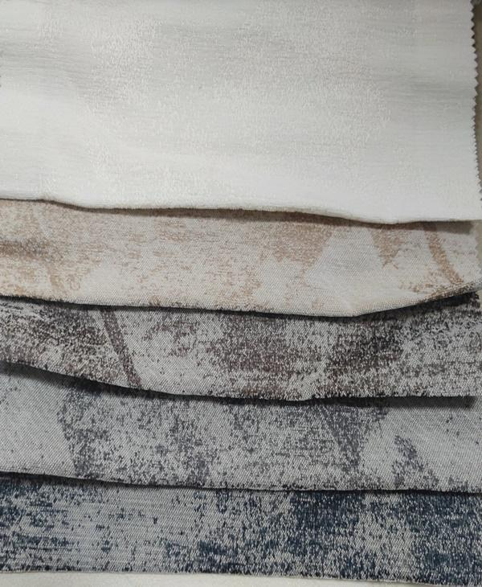
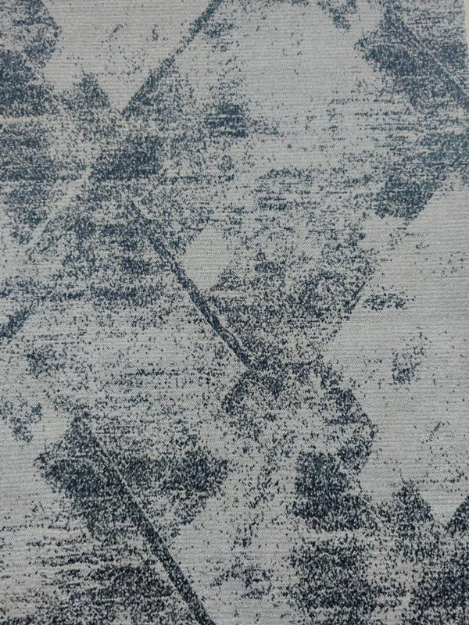
Ningbo Health Textile Co.,Ltd
Style No.HS12137

Slide 7
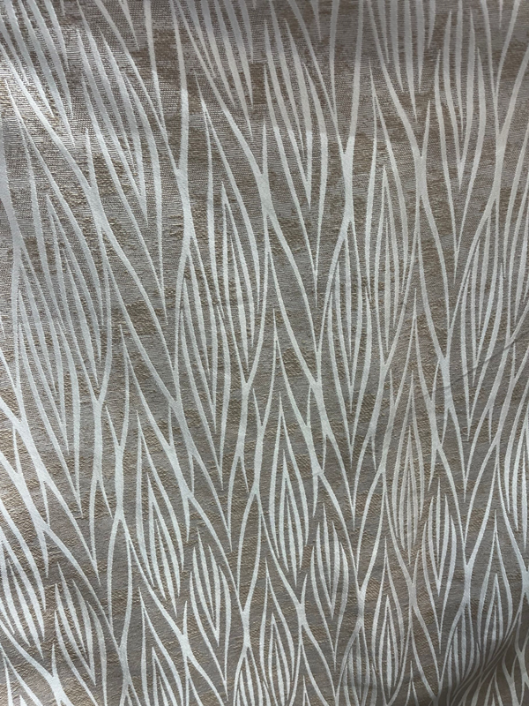
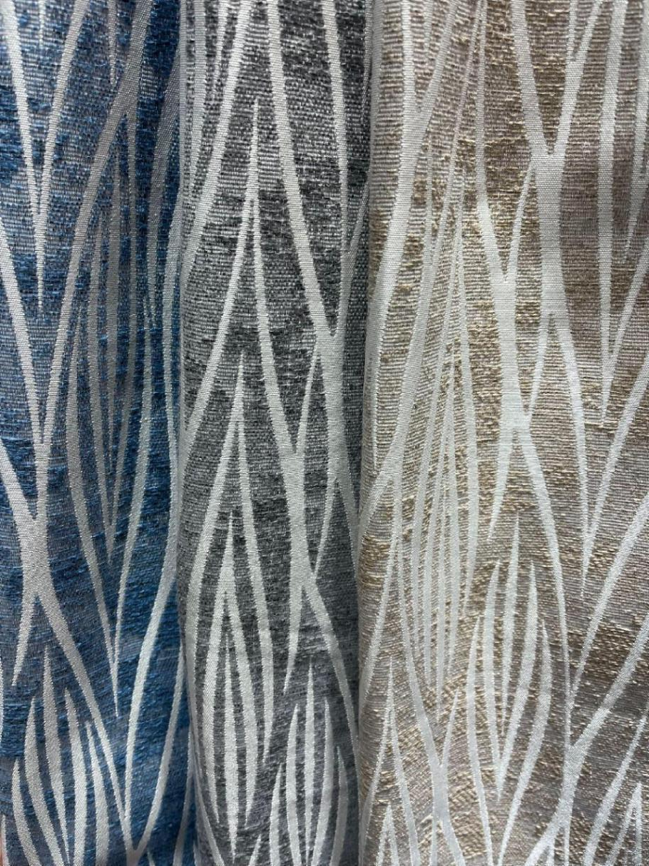
Ningbo Health Textile Co.,Ltd
Style No.230561

Slide 8
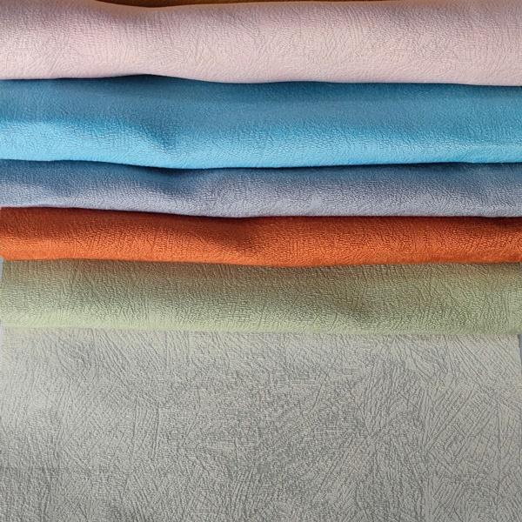
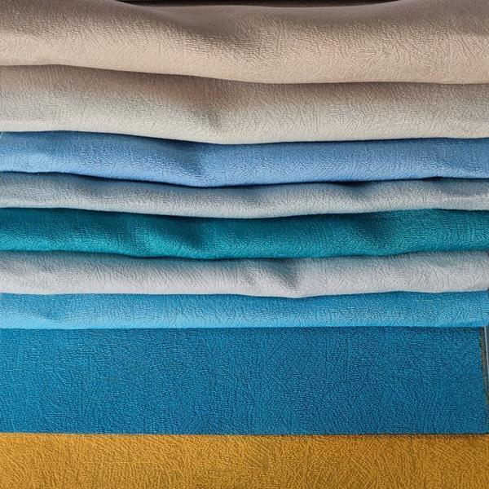
Ningbo Health Textile Co.,Ltd
Style No.HS12043

Slide 9
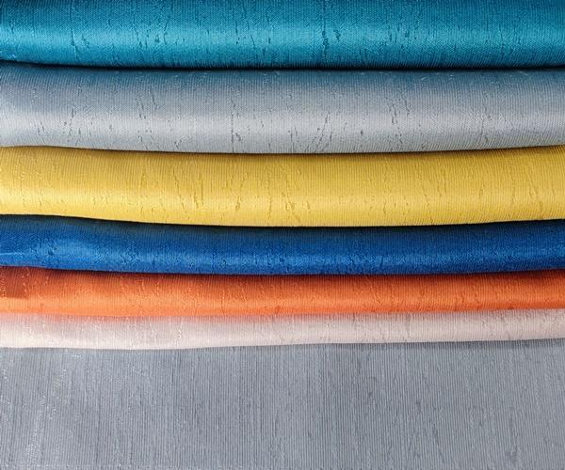
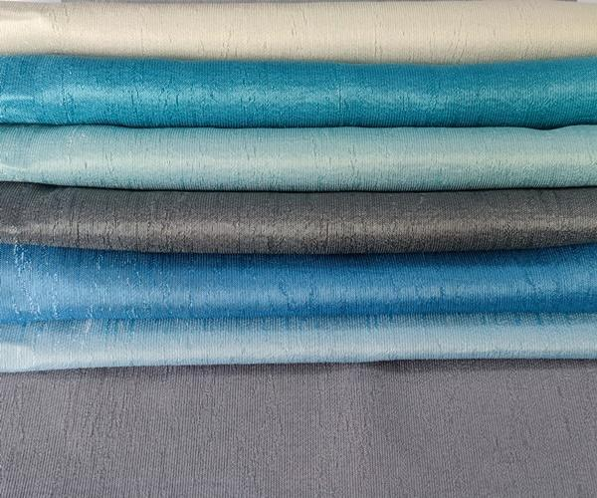
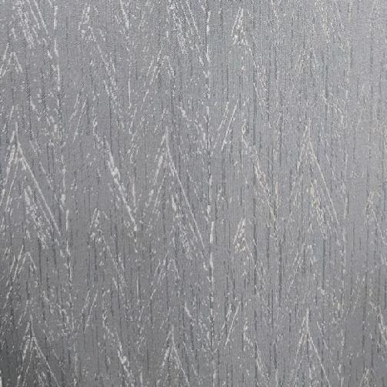
Ningbo Health Textile Co.,Ltd
Style No.HS12044

Slide 10
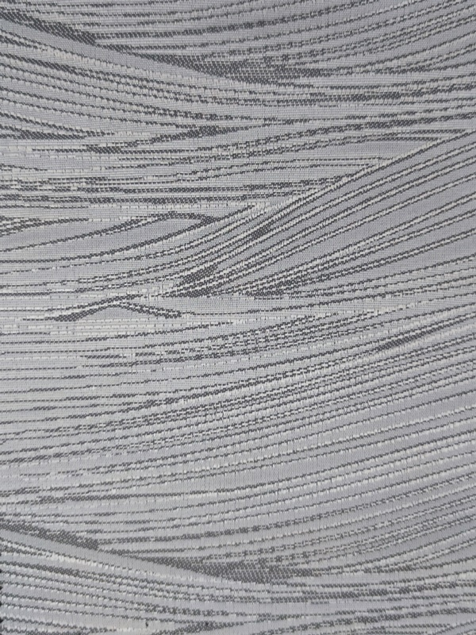
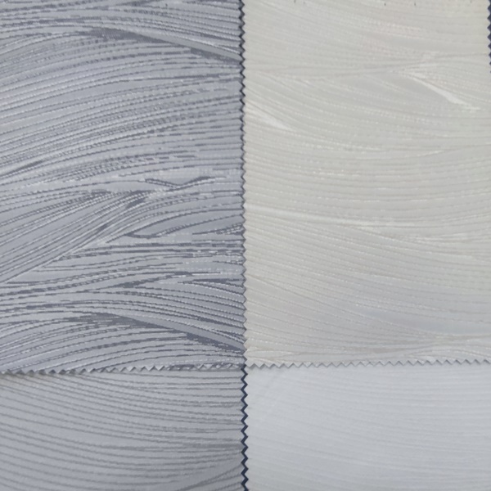
Ningbo Health Textile Co.,Ltd
Style No.HS11916

Slide 11
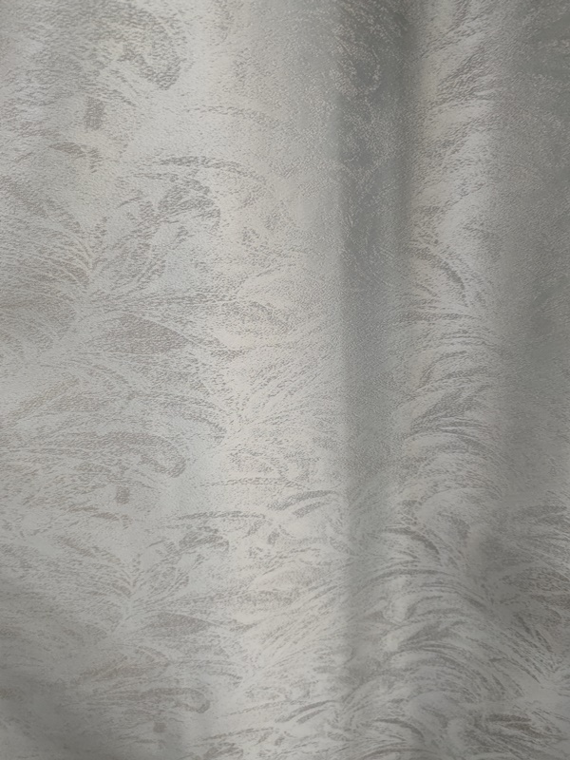
Ningbo Health Textile Co.,Ltd
Style No.HS11889

Slide 12
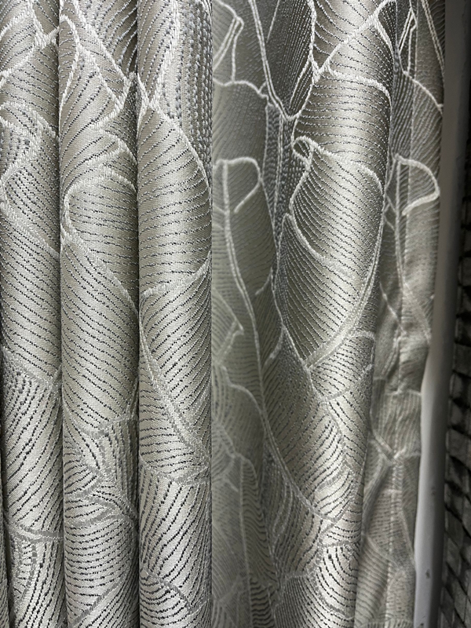
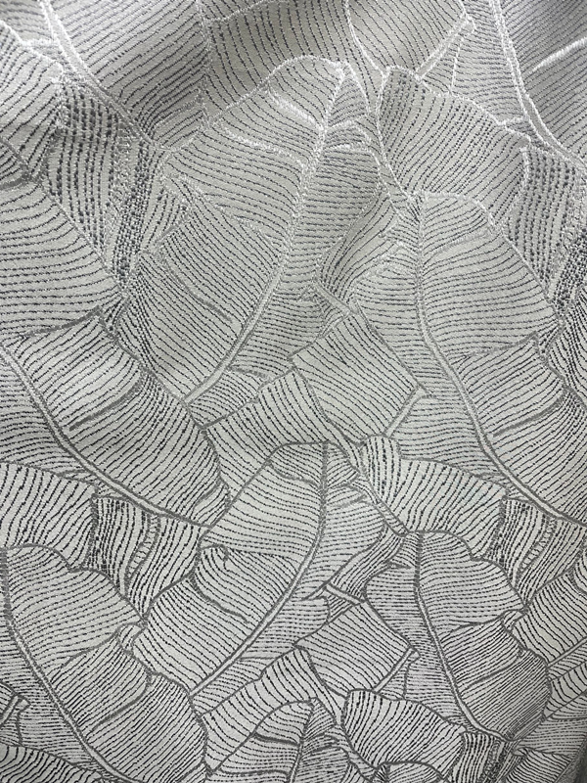
Ningbo Health Textile Co.,Ltd
Style No.HS12077

Slide 13
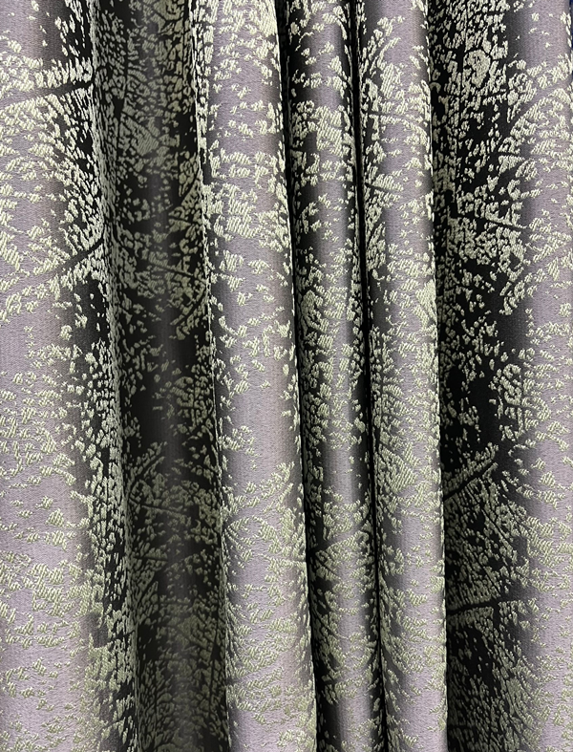
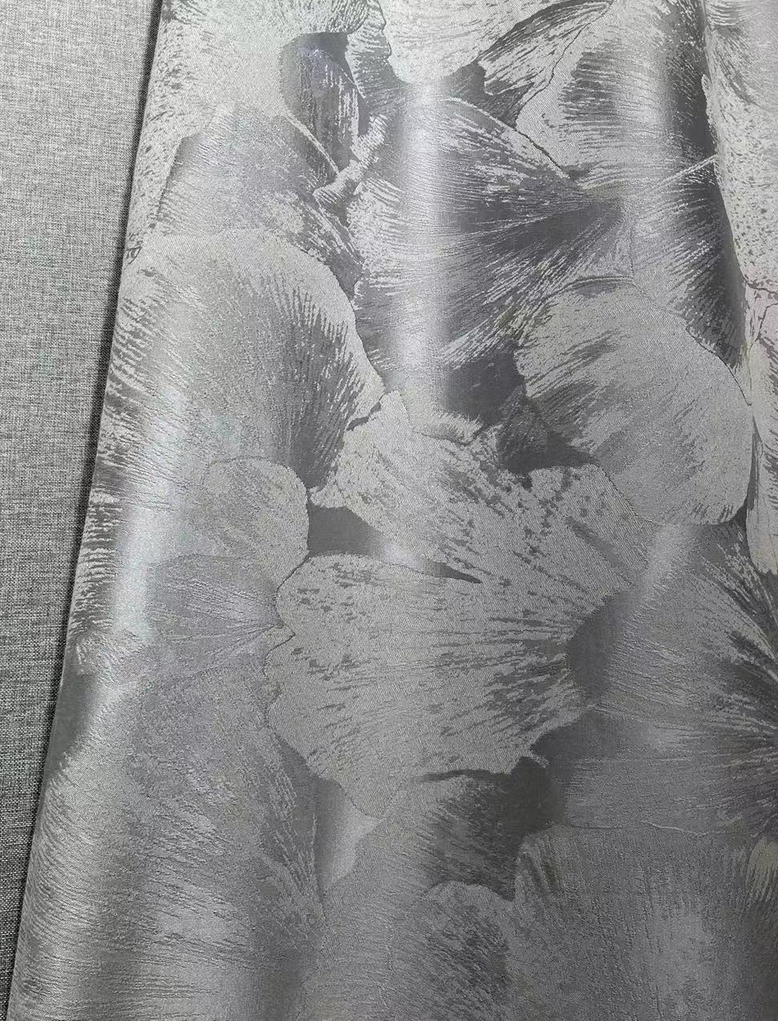
Ningbo Health Textile Co.,Ltd
Style No.HS12078
Style No.230801

Slide 14
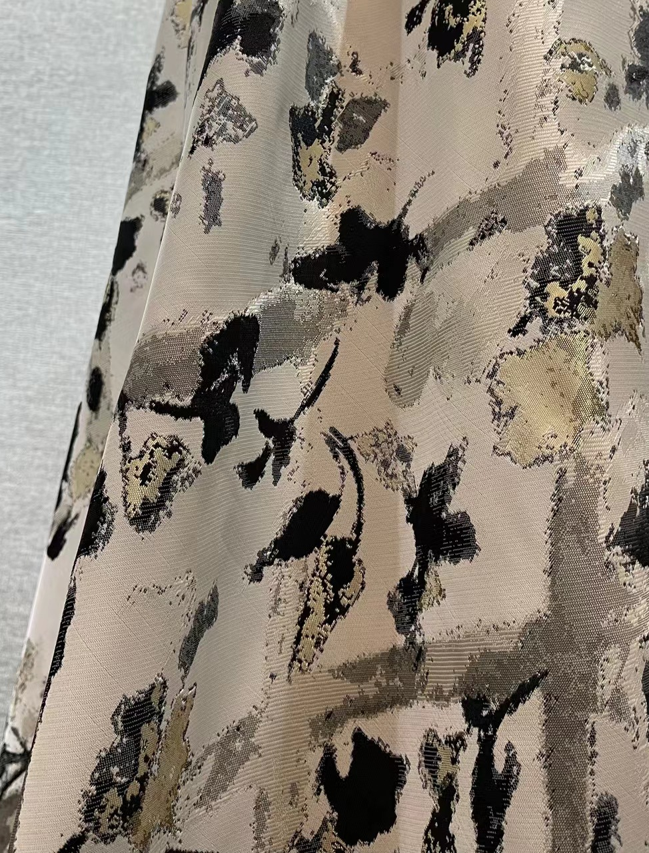
Ningbo Health Textile Co.,Ltd
Style No.HS12078
Style No.230801

Slide 15
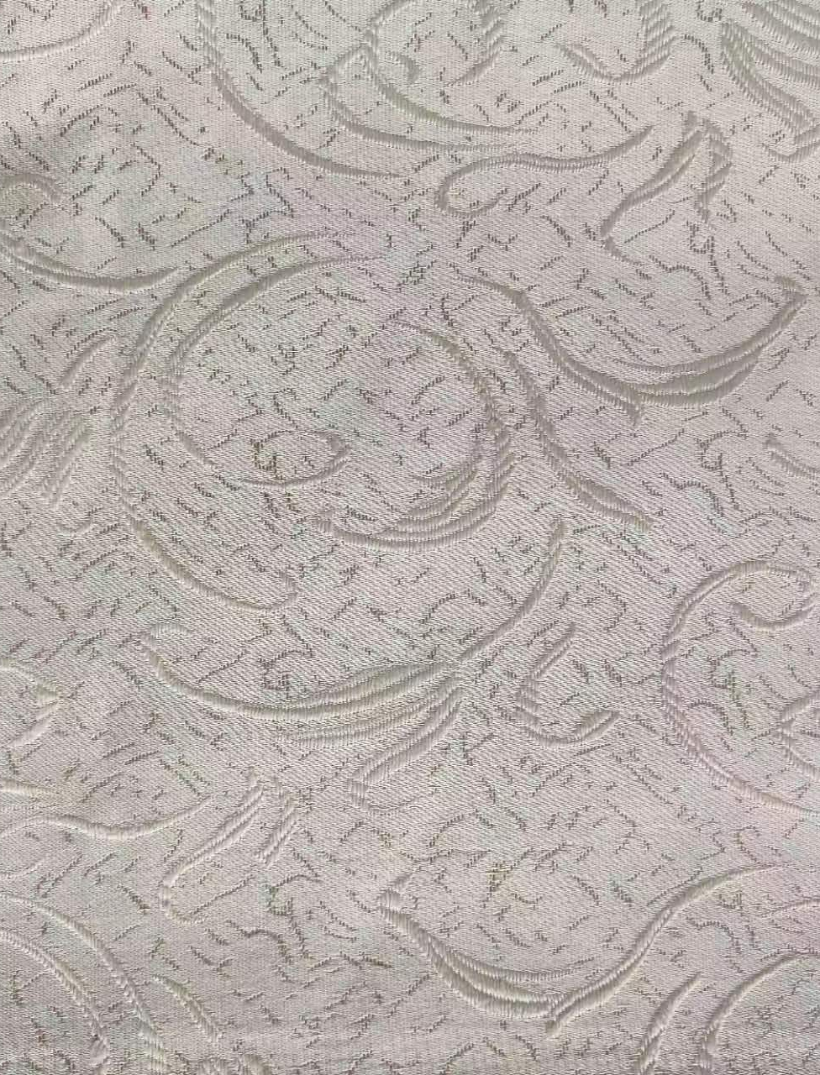
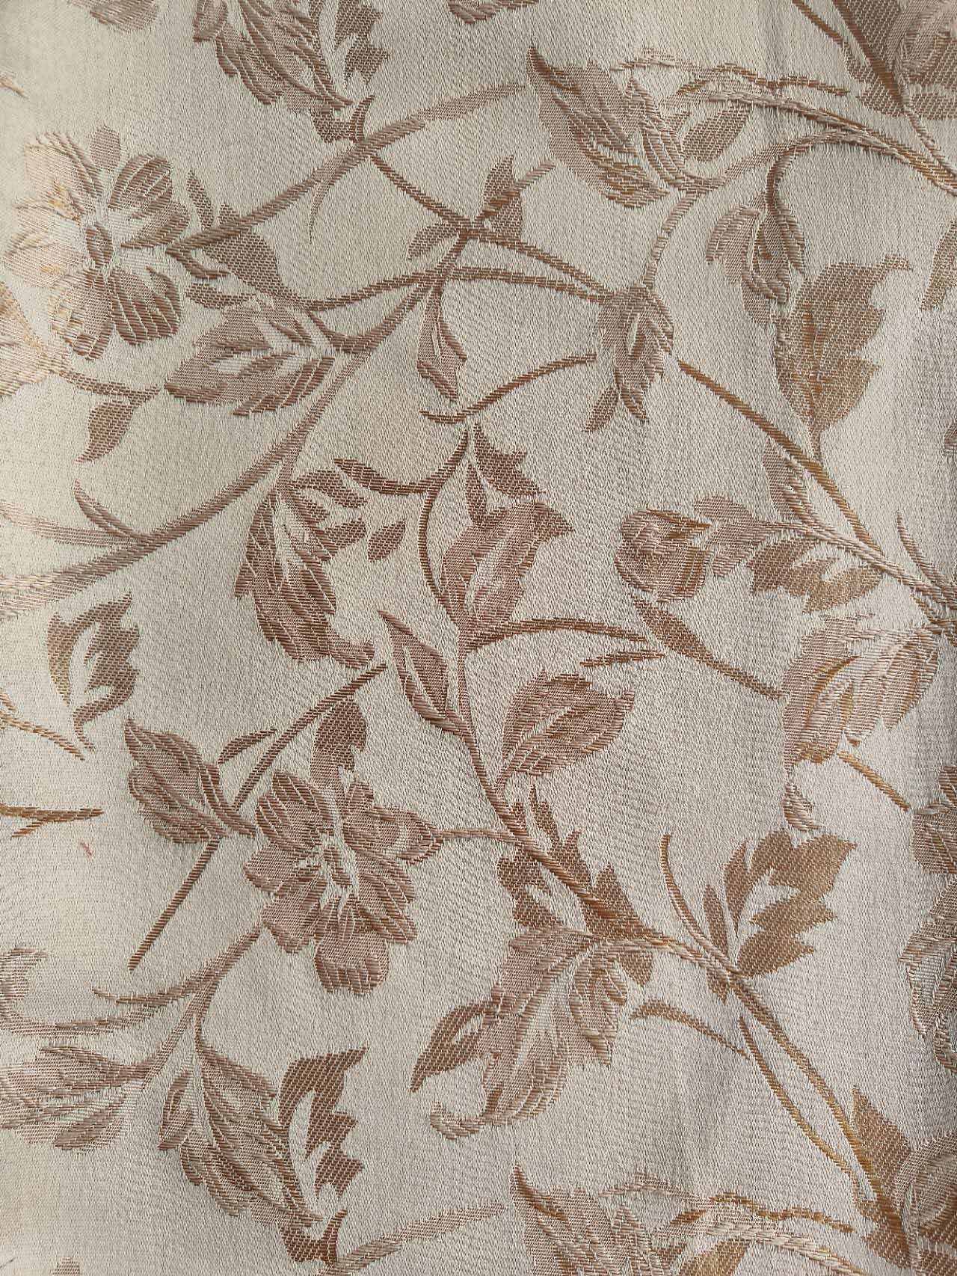
Ningbo Health Textile Co.,Ltd
Style No.230802
Style No.230803

Slide 16
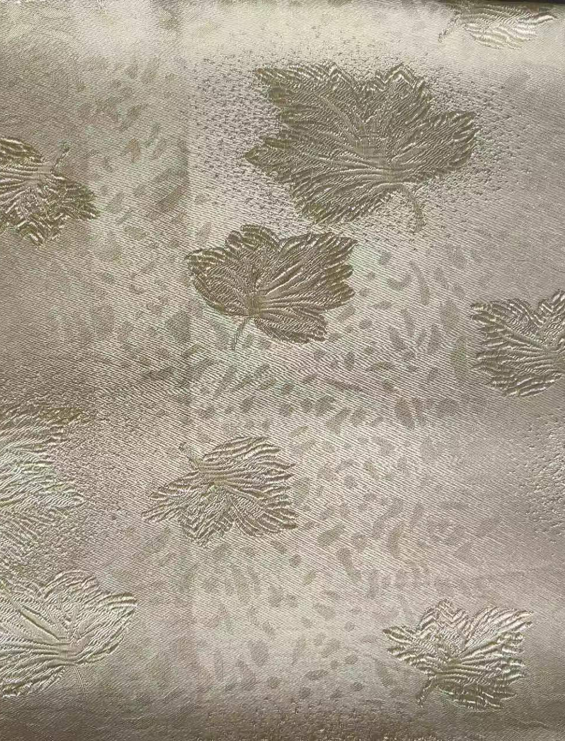
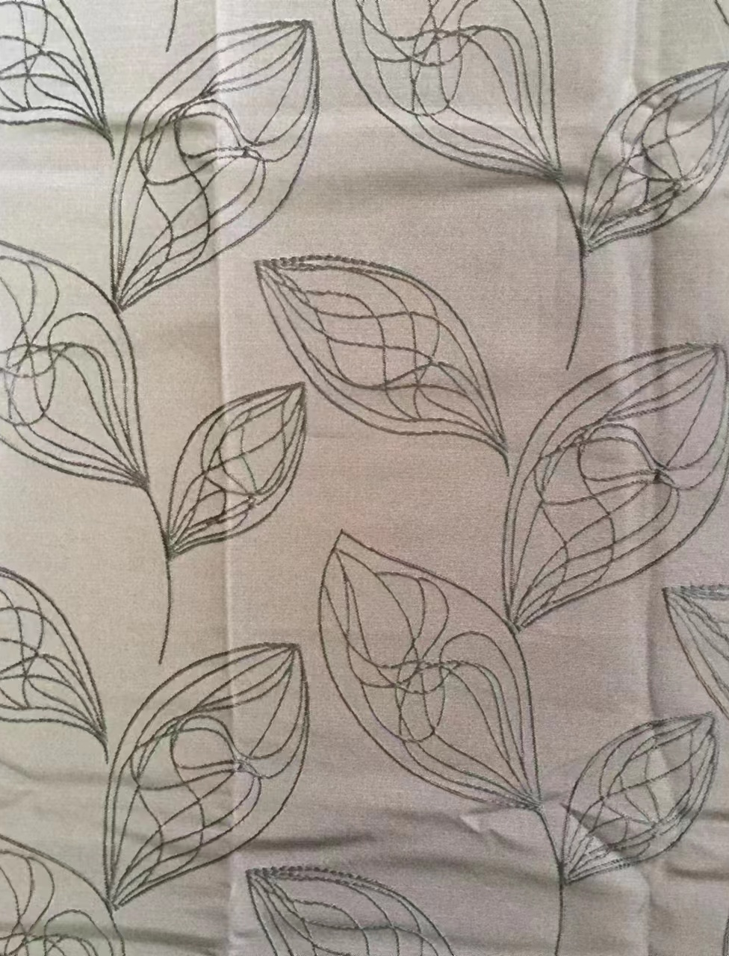
Ningbo Health Textile Co.,Ltd
Style No.230804
Style No.230805

Slide 17
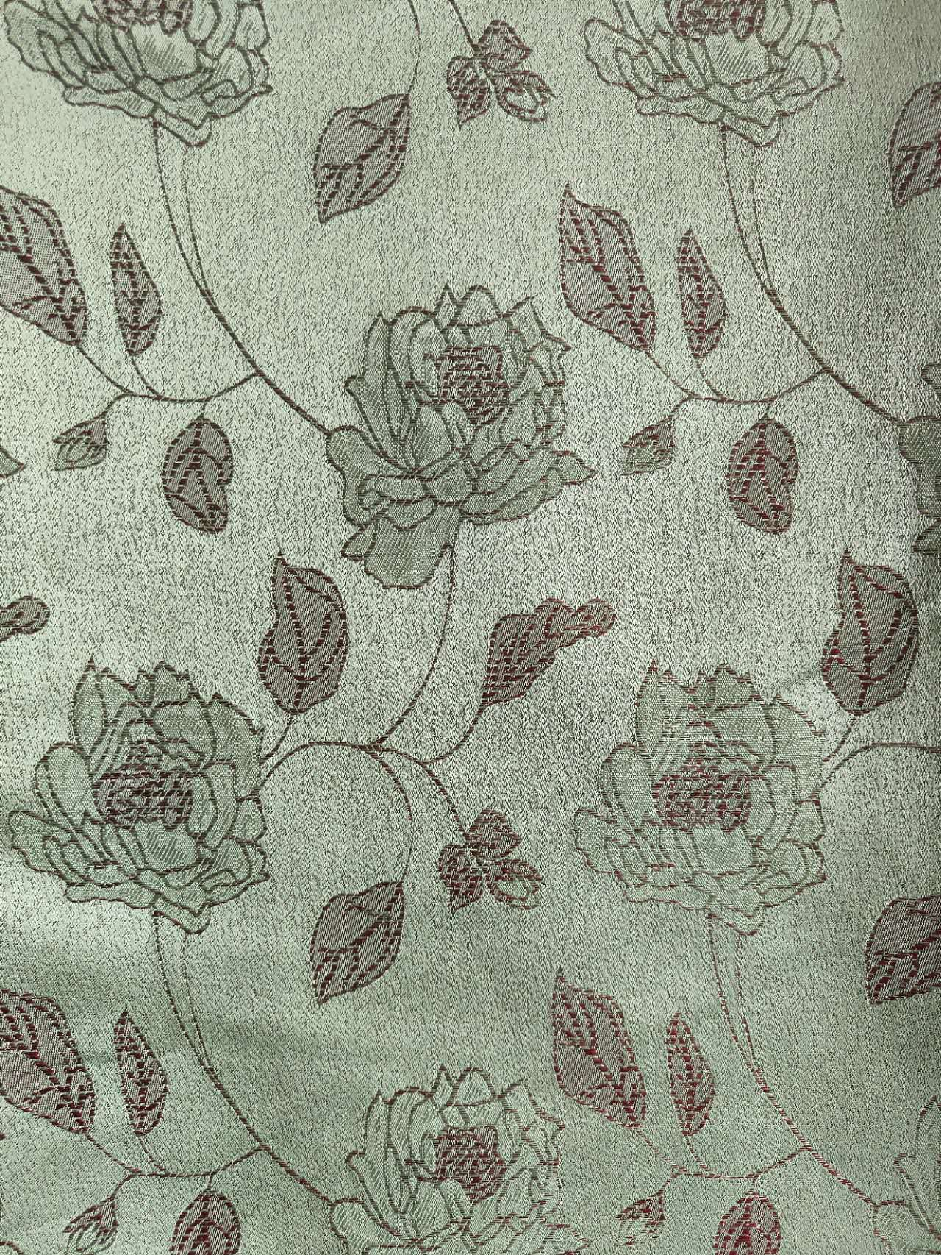
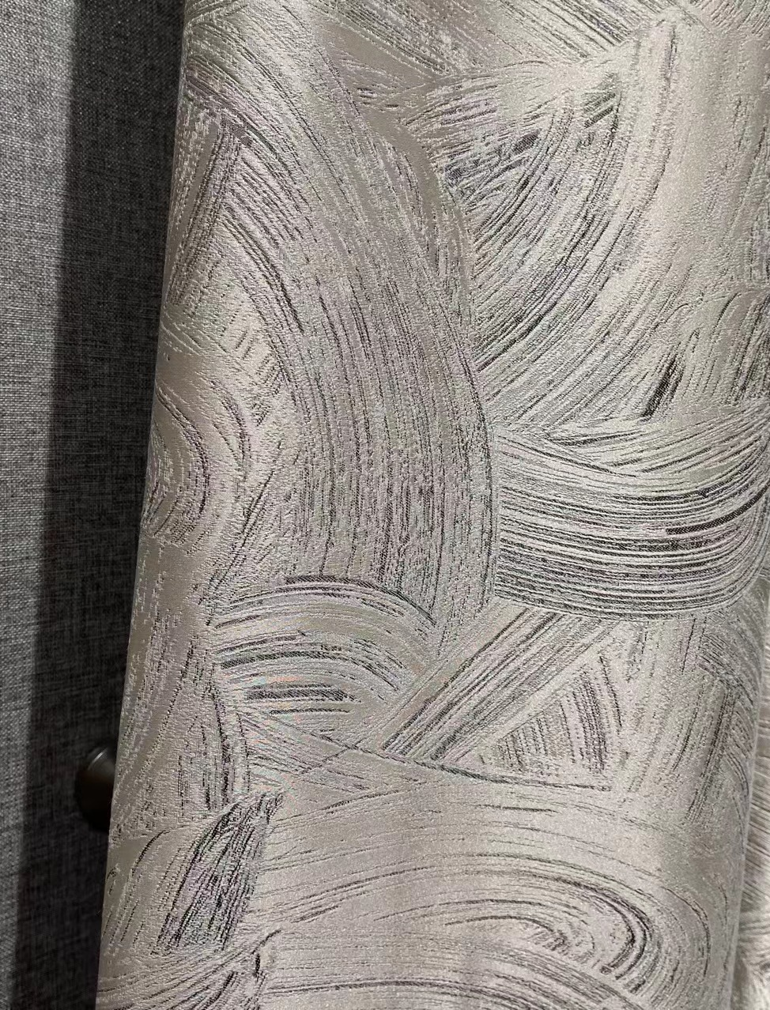
Ningbo Health Textile Co.,Ltd
Style No.230806
Style No.230807

Slide 18
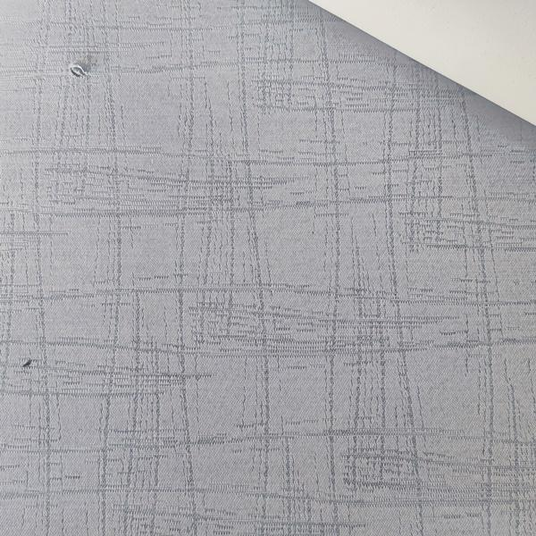
Ningbo Health Textile Co.,Ltd
Style No.HS12024
Style No.30331

Slide 19
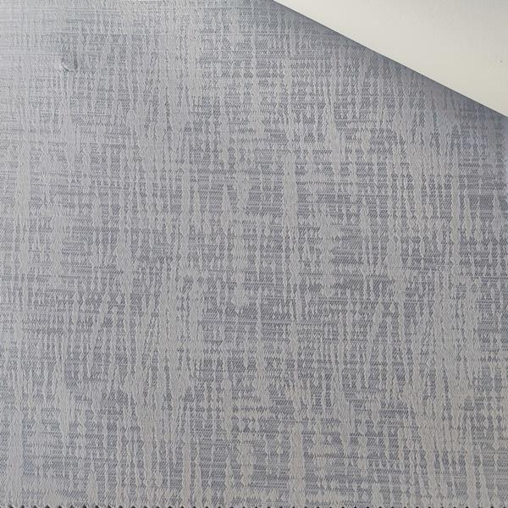
Ningbo Health Textile Co.,Ltd
Style No.HS12032
Style No.HS12027

Slide 20
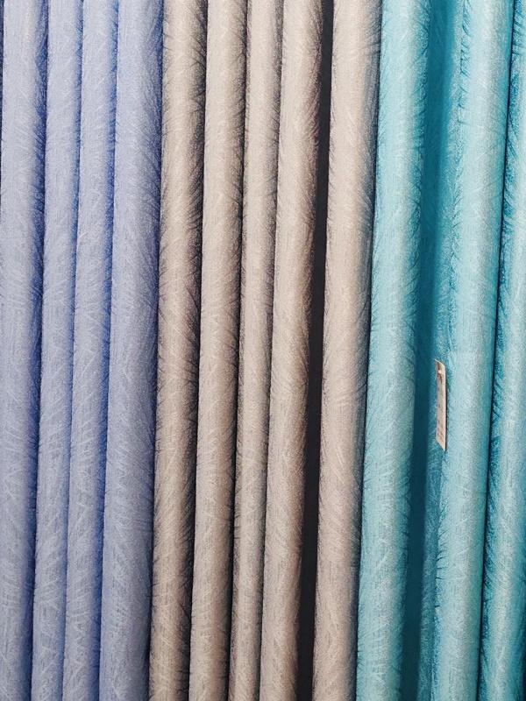
Ningbo Health Textile Co.,Ltd
Style No.230230

Slide 21
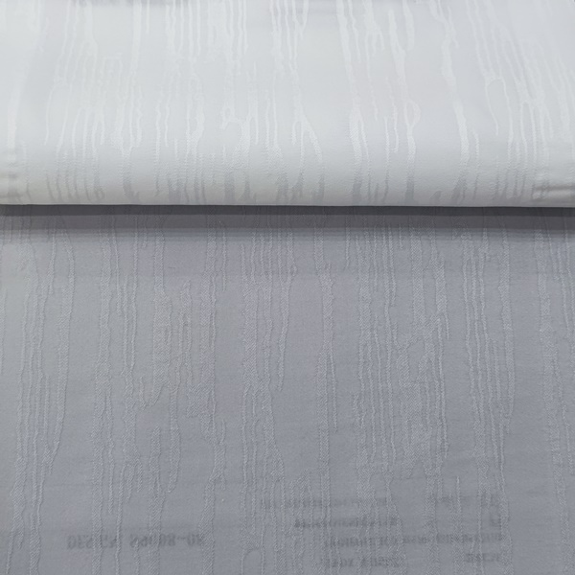
Ningbo Health Textile Co.,Ltd
Style No.30344

Slide 22
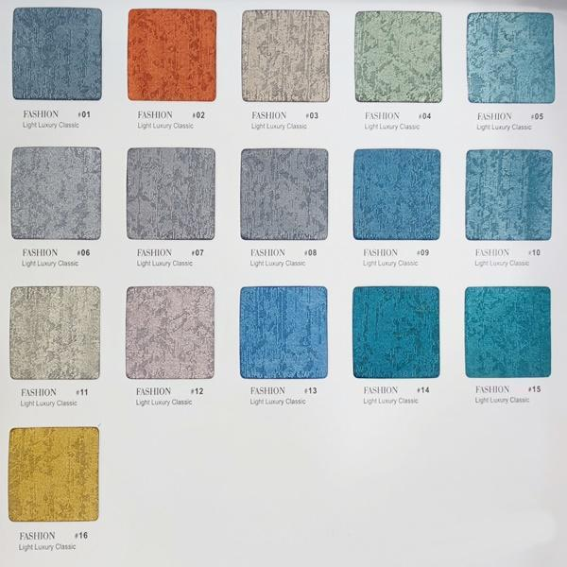
Ningbo Health Textile Co.,Ltd
Style No.230213

Slide 23
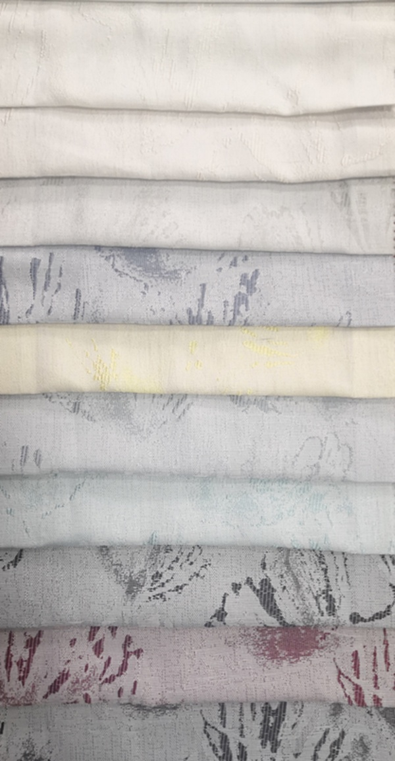
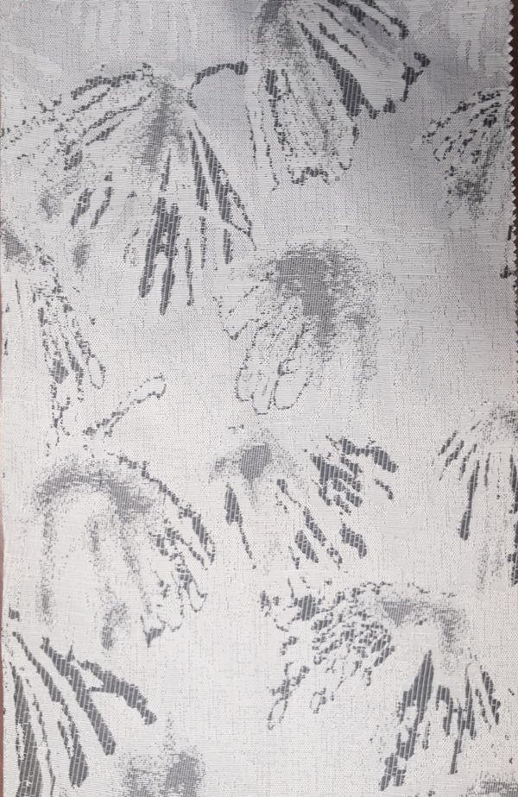
Ningbo Health Textile Co.,Ltd
Style No.HS11618

Slide 24
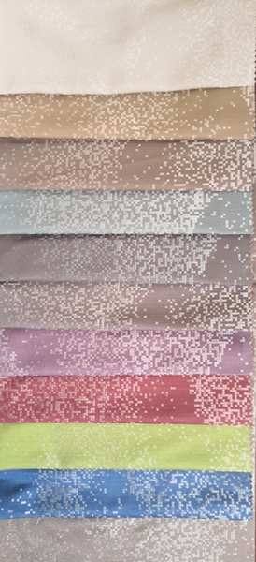
Ningbo Health Textile Co.,Ltd
Style No.HS11230

Slide 25
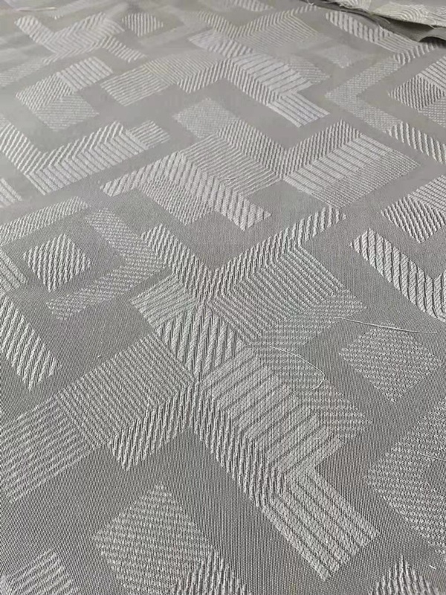
Ningbo Health Textile Co.,Ltd
Style No.HS11850

Slide 26
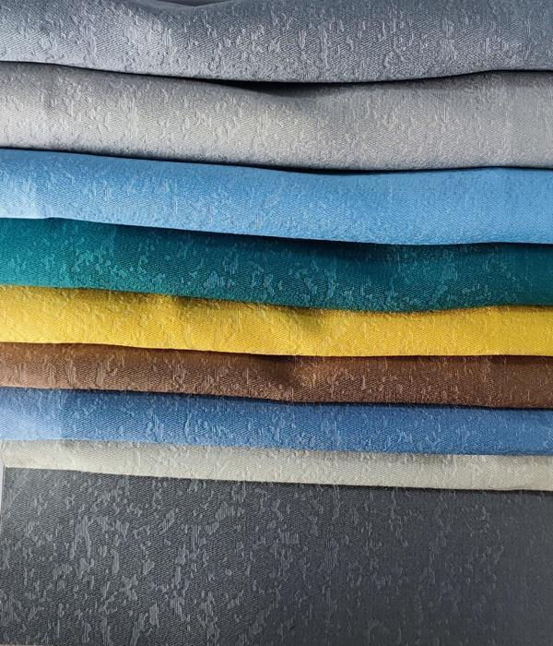
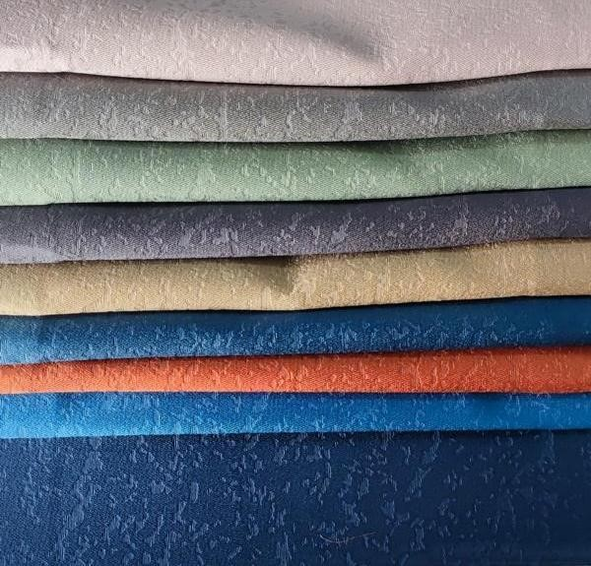
Ningbo Health Textile Co.,Ltd
Style No.HS12048

Slide 27
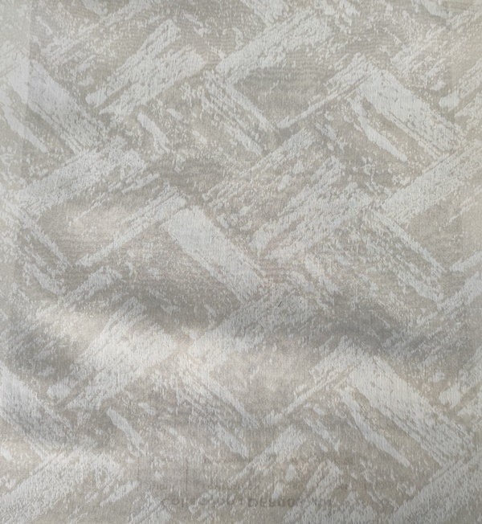
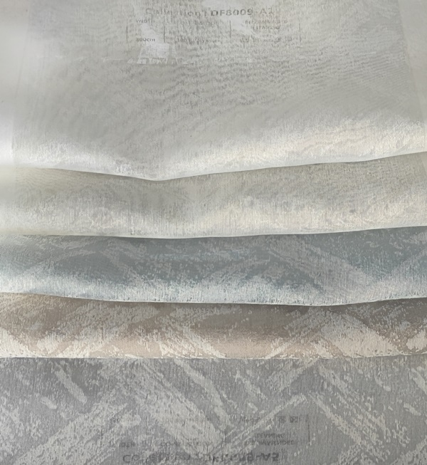
Ningbo Health Textile Co.,Ltd
Style No.HS11971

Slide 28
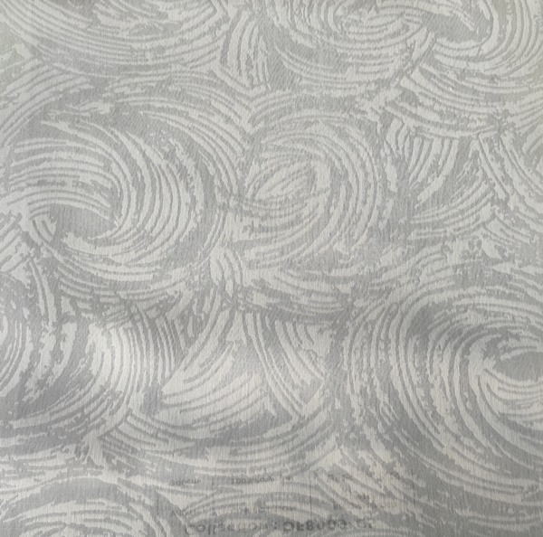
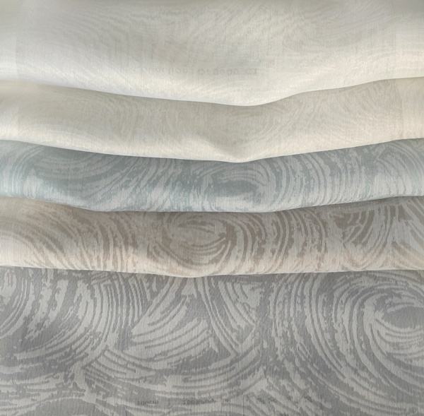
Ningbo Health Textile Co.,Ltd
Style No.HS11973

Slide 29
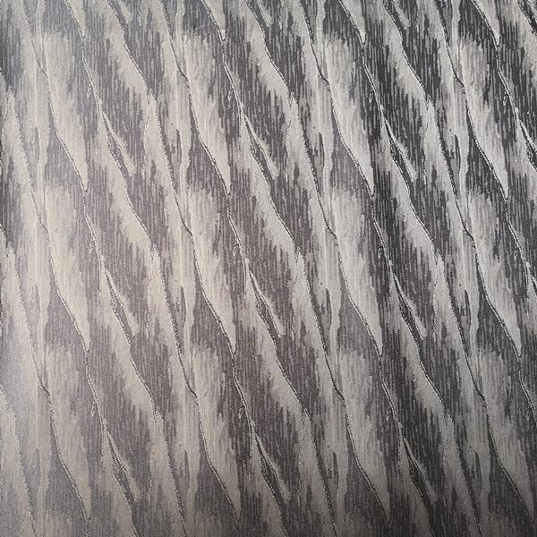
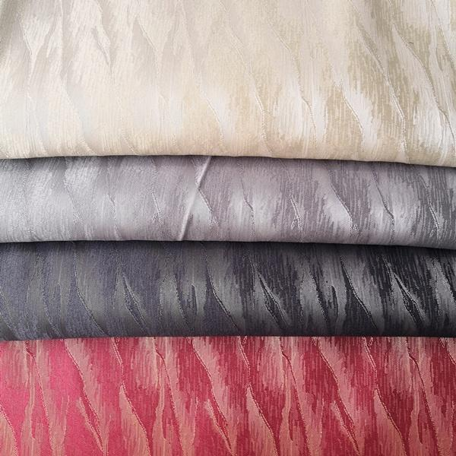
Ningbo Health Textile Co.,Ltd
Style No.HS11646

Slide 30
We welcome you to contact us :
Ningbo Health Textile Co., Ltd.
Add : Rm no. 212, Jinxiu Building , #77-1 , Donghuan Rd ,
Fenghua,Ningbo,China
Tel : 0086-13586821262
Mobile: 0086- 13586821262
Fax : 0574-88932622
E-mail : becky.xu@health-fh.com sam.si@health-fh.com
P.C : 315500
Thanks For All Your Supportings !

